Slide 1
Battle of the Neighbourhoods
Aritra Koley

Slide 2
Introduction
Background
Most people who need to settle outside their own cities have little to no experience of living in an unfamiliar environment.
Settling where basic facilities of their hometown are present just makes things easier.
Problem
Find areas that are similar in terms of facilities and venues but are not in the same city.
Two areas will be deemed similar if the areas have similar categories of venues within a similar distance.
Locations with such similarity will be grouped into the same cluster.
Interest
People trying to move to a new city but would like the comforts of their old neighbourhood
People trying to expand their business into newer zones with similar demand and supply graphs.

Slide 3
Data Sources
User Input: The two locations to be compared, i.e. the names of the cities, the states they belong to and the country they are part of.
Coordinate Data: Geocoder service (eg: Geolake).
Pin codes: Web Scraping tables from www.mapsofindia.com
Nearby Venues Data: Foursquare API calls.

Slide 4
Data Sources
Most of the data obtained from the above-mentioned sources needed some sort of preprocessing before they could be fed into a machine learning or data analysis algorithm.
String names of the cities
Formatted into a list of dictionaries
Pin code tables:
Only the required table was converted into a pandas dataframe.
Columns ‘Location’, ‘District’ and ‘State’ were dropped.
New columns for ‘latitudes’ and ‘longitudes’ were added.
The Foursquare JSON data:
Only the required keys were retrieved
Flattened into a pandas dataframe with apt column names

Slide 5
Feature Selection
Venue names are varied but what determines the characteristics of a location are the categories for the venues in that region.
Therefore, the best feature to determine the type of a location are the categories of its top venues and the number of venues of the same category that occur within a given radius of that region.
Therefore, the categories found in both cities were one-hot encoded to generate a feature-set for further application of a machine learning algorithms.
The mean of the one-hot encoded tuples grouped by the pincodes were taken as the feature set for clustering and classification.

Slide 6
Modelling
The approach taken to modelling the problem using machine learning algorithms once the feature sets were obtained can be summarized in a simple two-step process.
Clustering Points in Base City
Classifying Points in Target City based on Base City Clusters

Slide 7
Clustering Points in Base City
The first phase uses simple K-Means clustering to group similar locations in the base city
Only the data corresponding to the Base City was used to perform clustering so that the various classes of the locations can be determined before similarity analysis with the target city.
The value of K was set to 5 for the demonstrative purposes of this report. Therefore, in this phase the classes were determined.

Slide 8
Classifying Points in Target City based on Base City Clusters
The second phase uses the information gained form the first phase to determine which locations in the target city are similar to the corresponding locations in the base city.
The classification technique used in the second phase is simple K-Nearest Neighbour approach with a value of K set to 5 and weights taken as the inverse of the distance between the points.
Therefore, in this case the locations in the target city were classified based on the determined classes in the clustering phase.

Slide 9
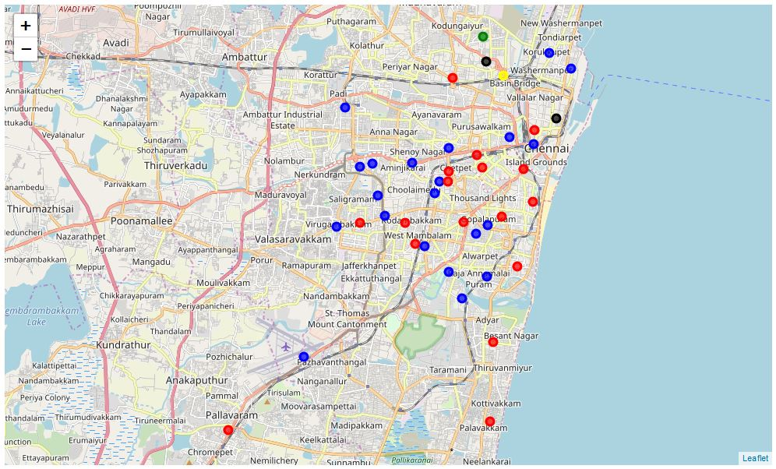
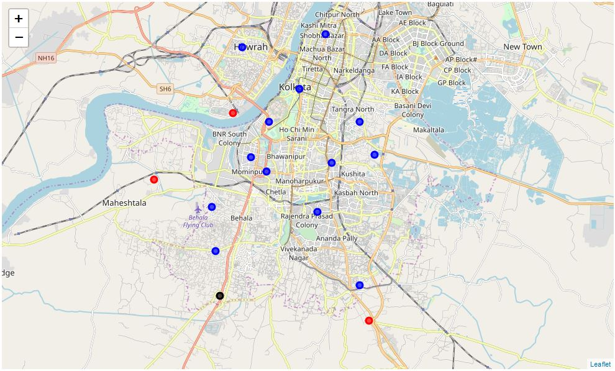
Results
Clustering Chennai Locations
Classifying Kolkata Locations

Slide 10
Conclusions
The results show that the workflow is functional and is capable of detecting similar locations in two different cities.
We see that there are certain locations in Chennai that do not have suitable counterparts in Kolkata.
The class coloured blue is the most common type of location in both the cities with red coming a close second.
The black coloured locations are uncommon but present in both cities but towards the outskirts which might indicate either suburban or industrial associations.
More in-depth analysis will be required to determine the properties of each cluster as distinct form the other ones but for a preliminary similarity assessment of the locations of two cities, that sort of in-depth analysis is out of the scope of this report.

Slide 11
Future Works
Further work can be done to enhance the feature selection based on other factors apart from just popular venues.
Determination of the properties of each cluster and fine-tuning of the parameters for the algorithms or even using new innovative algorithms to determine classes and then classify based on them are possible in later stages.
It might be possible to develop this kind of a service into an app that allows access to information and analysis of this sort readily instead of a machine learning workflow format.

